Slide 1

Bank Transaction Fraud Detector
Real-time Bank Transaction Fraud Detection

Slide 2

The Problem: Escalating Fraud & Manual Limitations
High Transaction Volume: Billions of transactions daily, making manual review impossible.
Manual Review Inefficiency: Slow, error-prone, and unable to detect sophisticated fraud patterns.
Cost of Missed Fraud: Each undetected fraudulent transaction leads to direct financial losses and reputational damage.
Potential Losses Prevented: Automated detection can prevent millions in annual losses.

Slide 3
Objective & Success Criteria
Objective: To develop and deploy a robust machine learning model for real-time detection of fraudulent bank transactions, minimizing financial losses and improving operational efficiency.
High Recall Rate
Acceptable False Positive Rate
Real-time Flagging
Identify >95% of all fraudulent transactions.
Process transactions and flag potential fraud within milliseconds.
Maintain false positives <10% to minimize legitimate transaction disruptions.

Slide 4
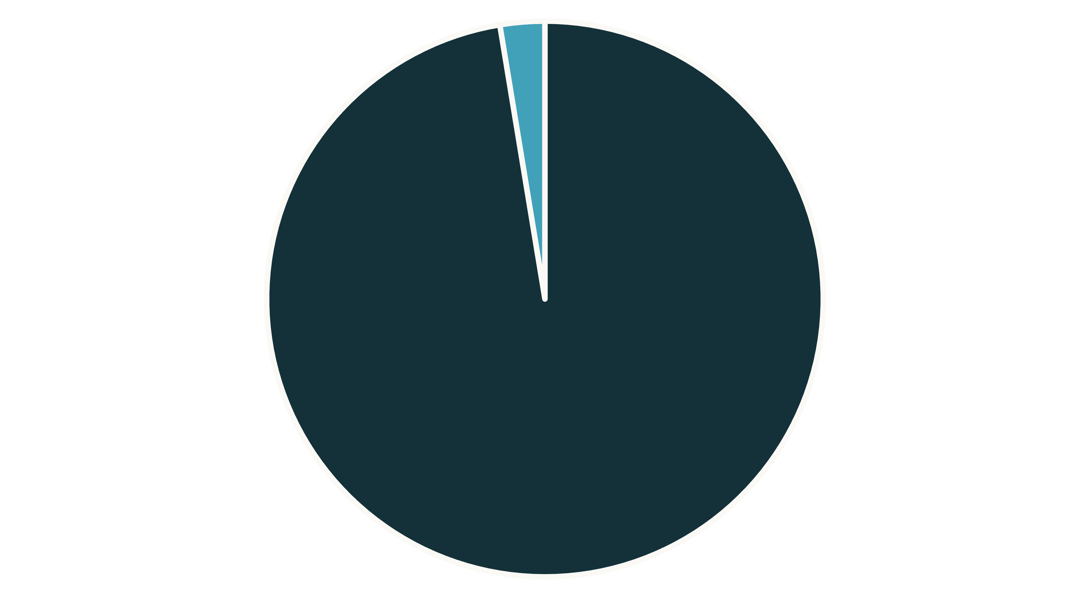
Dataset Summary: Understanding Our Data
Dataset Source
AIML Dataset.csv
Total Records
16,426 rows of bank transaction data.
Total Features
11 columns capturing transaction details.
Target Variable
"isFraud" (binary: 0 for legitimate, 1 for fraudulent).
Legitimate
Fraudulent
Fraud Rate: Approximately 2.6% of transactions are fraudulent, highlighting class imbalance.

Slide 5


Feature Engineering: Enhancing Model Insights
Raw transaction data was transformed into more predictive features. Each engineered feature provides unique insights into transaction behavior, improving the model's ability to distinguish between legitimate and fraudulent activities.
Raw Data
Engineered Features
Amount
Time (hour): Derived from 'step' to capture hourly patterns.
Step (time)
Transaction Type
Transaction Type (encoded): Categorical types converted for model use.
Balance Change (origin/destination): Reflects changes in account balances, often indicative of fraud.
Is Round Amount: Binary flag for suspicious, round-number transactions.

Slide 6






Modeling Approach: Identifying Fraud Patterns
We explored both supervised and unsupervised learning techniques to build our fraud detection system. A stratified split ensured representative training and testing sets, while class weighting addressed data imbalance.
Logistic Regression
Random Forest
Isolation Forest
A simple, interpretable baseline model.
Powerful ensemble model for high accuracy.
Unsupervised anomaly detection to identify outliers without labeled data.

Slide 7
Model Performance: Comparative Analysis
The Random Forest model significantly outperformed other approaches, demonstrating superior ability to detect fraud while maintaining high overall accuracy.
Model
Precision
Recall
F1 Score
ROC-AUC
Logistic Regression
0.93
0.93
0.93
0.983
Random Forest
0.99
0.99
0.99
0.9997
Isolation Forest
0.46
0.46
0.46
0.4624
Accuracy: Random Forest ≈ 99.33%

Slide 8
Confusion Matrices & Business Impact
Random Forest Confusion Matrix
Logistic Regression Confusion Matrix
Predicted Safe
Predicted Fraud
Predicted Safe
Predicted Fraud
Actual Safe
1622
21 (False Positives)
Actual Safe
1542
101 (False Positives)
Actual Fraud
1 (False Negative)
1642
Actual Fraud
119 (False Negatives)
1524
False Positives: Legitimate transactions flagged as fraud. Can lead to minor customer inconvenience (e.g., card holds).
Tradeoffs: Random Forest significantly reduces False Negatives, which are more costly. False Positives from RF can be routed to a manual review queue.
False Negatives: Fraudulent transactions missed by the model. Directly results in financial loss for the bank.

Slide 9
Demo: Real-time Prediction with Streamlit
Example Prediction:
Key Features:
Input: Amount: 24000, Type: ATM, Location: Unknown Prediction: Fraudulent
Upload CSV for batch prediction.
Train models directly within the app.
Single-transaction real-time prediction.
Generate random transactions for testing.
Save and load trained models.

Slide 10

Next Steps :
Future Enhancements for Production Readiness:
Persist Preprocessing: Integrate scaler and encoders into the model pipeline for seamless deployment.
Deploy API: Implement a FastAPI endpoint for low-latency real-time predictions.
Monitoring & Retraining: Establish a cadence for model performance monitoring and scheduled retraining to adapt to evolving fraud patterns.
Threshold Tuning: Collaborate with business stakeholders to fine-tune fraud detection thresholds based on risk appetite.
Enrichment: Incorporate user-level aggregates and geolocation data for enhanced feature engineering.

